Slide 1
Mutually Exclusive Events
Two events are incompatible, disjoint or mutually exclusive when the occurrence of one precludes the occurrence of the other, i.e. they can not occur at the same time.

Slide 2
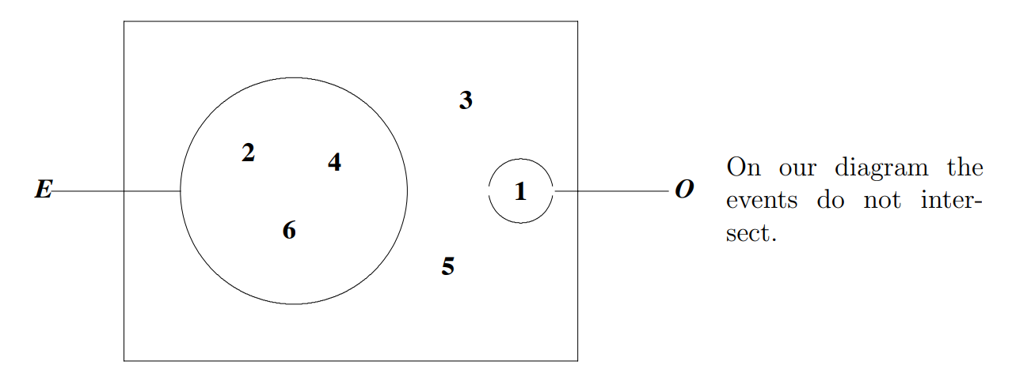
Example:
Suppose a die is tossed. Then the events E = ‘obtaining an even number’ and O = ‘obtaining a one’ are mutually exclusive

Slide 3
Notice that
$P\left(throwing an even number or one\right)=P(1,2,4,6)$ $=\frac{4}{6}=P\left(E\right)+P(O)$.
Note : For any two events $A$ and $B$, $P(A ∪ B) = P(A) + P(B) − P(A ∩ B).$If $A$ and $B$ are mutually exclusive then $P(A ∩ B) = 0$, and A and B cannot happen together, so that $P(A ∪ B) = P(A) + P(B).$

Slide 4
Conditional Probability
The conditional probability of A given B is defined by:-$P\left(A\right|B)=\frac{P(A∩B)}{P(B)} provided that P\left(B\right)≠0$
Hence if A and B are any two events with probabilities greater than 0, then
$P\left(A∩B\right)=$ $P\left(A\right|B)P\left(B\right).$

Slide 5
Example#: A lecture on a topic of public health is held and 300 people attend. They are classified in the following way:
Find the following probabilities
1-$P\left( a doctor is chosen \right);$
2- $P\left( a female is chosen \right);$
3- $P\left( a nurse is chosen \right);$
4-$P\left( a male is chosen \right);$
5- $P\left( a female nurse is chosen \right);$
6- $P\left( a male doctor is chosen \right);$
Total | Nurses | Doctors | Gender
180 | 90 | 90 | Female
120 | 20 | 100 | Male
300 | 110 | 190 | Total

Slide 6
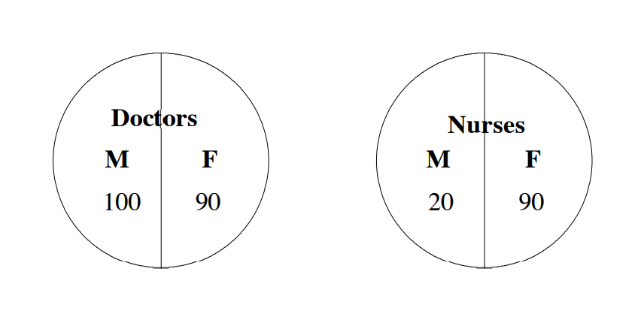
Solution:

Slide 7
1- The number of doctors is 190 and the total number of people is 300, so $P\left(doctor\right)=\frac{190}{300}$
2- $P\left(female\right)=\frac{180}{300}$
3- $P\left(male\right)=\frac{120}{300}$
4- $P\left(nurse\right)=\frac{110}{300}$
5- There are 90 female nurses, therefore $P\left(female∩nurse\right)=\frac{90}{300}$
6- $P\left( male doctor\right)=P\left( male ∩doctor\right)=\frac{100}{300}$

Slide 8
Now suppose you are given the information that a female is chosen and you wish to find the probability that she is a nurse. This is what we call conditional probability. We want the probability that the person chosen is a nurse, subject to the condition that we know she is female. The notation used for this is:
$$P\left(nurse | female\right)$$
Read this as ‘the probability of the person chosen being a nurse, given that she is female’. Since there are 180 females and of these 90 are nurses, the required probability is $\frac{90}{180}=\frac{1}{2}$ .
We can see that $P\left(nurse | female\right)=\frac{90}{180}$
$=\frac{{90}/{300}}{{180}/{300}}= \frac{P(nurse ∩ female)}{P(female)}$

Slide 9
Independent Events
Incidents A or B are independent incidents If the occurrence of one of them or not Its occurrence does not affect the occurrence of the other . For example, when throwing a coin twice in a row the result of the second throw is not affected by the result of the first.
Two events A and B are said to be independent if and only if $P\left(A | B\right)=P\left(A\right),$ that is, when the conditional probability of A given B is the same as the probability of A.
Example ## :In the problem of nurses and doctors given on Example # , define A to be the event ‘a nurse is chosen’ and B to be the event ‘a female is chosen’. Are the events A and B independent?

Slide 10
Solution:
$$P\left(A | B\right)=\frac{90}{180}=\frac{1}{2}$$
$P\left(A\right)=\frac{110}{300}$ $≠P\left(A | B\right)$
So A and B are not independent.

Slide 11
Note: From the definition of conditional probability we have $P(A ∩ B) = P(B | A).P(A)$Now if $A$and $B$ are independent, then $P(A | B) = P(A), so P(A ∩ B) = P(A).P(B).$When two events are independent, the chance that both will happen is found by multiplying their individual chances. This gives us a simple way of checking whether or not events are independent: $A$ and $B$ are independent events if and only if $P(A ∩ B) = P(A).P(B).$
Note: It is possible to define independence in this way without referring to conditional probability.

Slide 12
مثال: عند رمي قطعتي نقود فما هو احتمال الحصول على صورة في كليهما.
نرمز لاحتمال الحصول على الصورة قطعة النقود الاولى ب P($H_{1}$) ولاحتمال الحصول على الصورة من قطعة النقود الثانية P($H_{2}$)
Sol.
S1={ H, T }قطعة النقود الاولى , رميت مره واحدة
s2={ H, T } قطعة النقود الثانية, رميت مره واحدة
نلاحظ ان كل قطعه نقود مستقلة عن الثانية لكن الحدث المطلوب هو رميها مع بعض وظهور الصورة
P($H_{1}H_{2}$)= P($H_{1}$). P($H_{2}$)=$\frac{1}{2} \frac{1}{2}= \frac{1}{4}$
P(A$∩B$)= P(A).P(B)
ملاحظة : عندما نقول رمينا قطعة نقود مرتين تكون غير مستقلة لأنها قطعة نقود واحدة

Slide 13
Complement
Let $A$ be an event. The complement of $A$, denoted by $A^{c}$, corresponds to the event that $A$ does not occur. By definition, we have $A ∩A^{c}= ∅$(the empty set) and
$A ∪A^{c}= S.$Here, the intersection operation $∩$ corresponds to “and”; and the union operation $∪$ corresponds to “or”. Since
$$1 = P\left(S\right)= P\left(A ∪A^{c}\right)= P\left(A\right)+ P\left(A^{c}\right),$$
$$we have P(A^{c}) = 1 − P(A) .$$

Slide 14
Example: Roll of a Die
$P\left(\left\{3\right\}\right)=\frac{1}{6}$
$$P\left(the outcome is not a 3\right)= 1 −\frac{1}{6} =\frac{5}{6}.$$

